Slide 1
Knowledge-driven Data Construction for Zero-shot Evaluation in Commonsense Question Answering Kaixin Ma, Filip Ilievski, Jonathan Francis Language Technologies Institute, School of Computer Science, Carnegie Mellon University
AAAI-2021
Li Wei
2021-3-28
Code: https://github.com/Mayer123/HyKAS-CSKG

Slide 2
Introduce
Due to increasing concern that large-capacity neural systems are modeling individual datasets, rather than learning how to perform logical reasoning or to utilize external knowledge effectively focus is shifting to alternative training and evaluation strategies. In particular, zero-shot evaluation shows promise as an efficient measure of model generalisability across tasks.
Zero-shot: models are trained and validated on task A, and tested on a different task B, without access to B’s training data or labels
Notes:
由于越来越多的人关注大容量神经系统正在对单个数据集建模，而不是学习如何执行逻辑推理或有效地利用外部知识，焦点正转向替代训练和评估策略。zero-shot评估显示出了作为跨任务模型可推广性的有效度量方法的希望。
zero-shot 评估：模型在任务A上进行训练和验证，并在不同的任务B上进行测试，而不需要访问B的训练数据或标签。

Slide 3
Motivation
While KBs have been shown to help in a zero-shot transfer setting recently ，no comprehensive study exists on the relation
between various knowledge, its usage method, and neural models for zero-shot transfer across commonsense tasks.
Notes:
常识性的知识库，在常识性QA任务之间具有一致的收益性。
虽然最近KBs已经被证明可以帮助Zero-shot转移设置，但在常识任务中各种知识、其使用方法和零枪击转移的神经模型之间的关系方面，还没有全面的研究

Slide 4
Mathod
(1) Design a novel neuro-symbolic framework that investigates the
dependency between knowledge sources, question generation techniques, language model (LM) variants, and tasks.
(2) We expand on prior work to devise and test four distractor-sampling strategies for effective question generation.
Notes:
1、设计了一个新的神经符号框架，研究知识来源、问题生成技术、语言模型(LM)变体和任务之间的依赖关系
2、我们扩展了之前的工作，以设计和测试四种干扰取样策略，以有效地产生问题

Slide 5
Method
Synthetic QA Generation
We generate questions, answers, and distractor options from five KGs:
ATOMIC
ConceptNet
WordNet
VisualGenome
Wikidata
found in the Commonsense Knowledge Graph (CSKG)

Slide 6
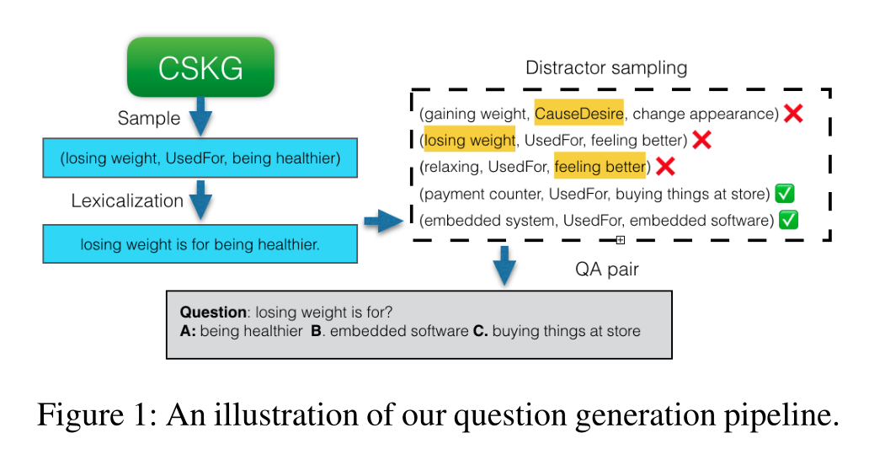
Method
Generating questions and answers
Notes:
对于一个三元组：我们使用一组预定义的模板，在词法化步骤中生成一个句子

Slide 7
Method
Generating negative samples (distractors)
(1)the tails of knowledge triples (h0, r0, t0) with the same relation r0= r, randomly sampled from the KGs.
(2) The head h0 of the sampled triples does not have non-stop word overlap with h
(3) The distractor tail t0 is not part of the correct answer set,there exist no triples, (h, r, t0)
Notes:
产生负采样规则:
(1)关系相同
（2）干扰项的头部与正确答案的头部不相交
（3）干扰项不是正确答案的子集
第一个干扰项由规则1过滤
第二个干扰项由规则2和规则3过滤
第三个干扰项由规则3过滤

Slide 8
Method
Distractor Sampling
random strategy
select distractors that are as similar as possible to the answer, while being under a certain threshold (adv-answer)
(3) select distractors that are as similar as possible to the question, while being under a certain threshold (adv-question)
(4) We employ the AFLite algorithm to keep the most challenging
subset to train our models
Notes:
产生负采样规则:
(1)随机策略
（2）在一定的阈值下，选择与答案尽可能相似的干扰物
（3）在一定的阈值下，选择与问题尽可能相似的干扰物
(4)采用Aflite过滤掉简单的负采样

Slide 9
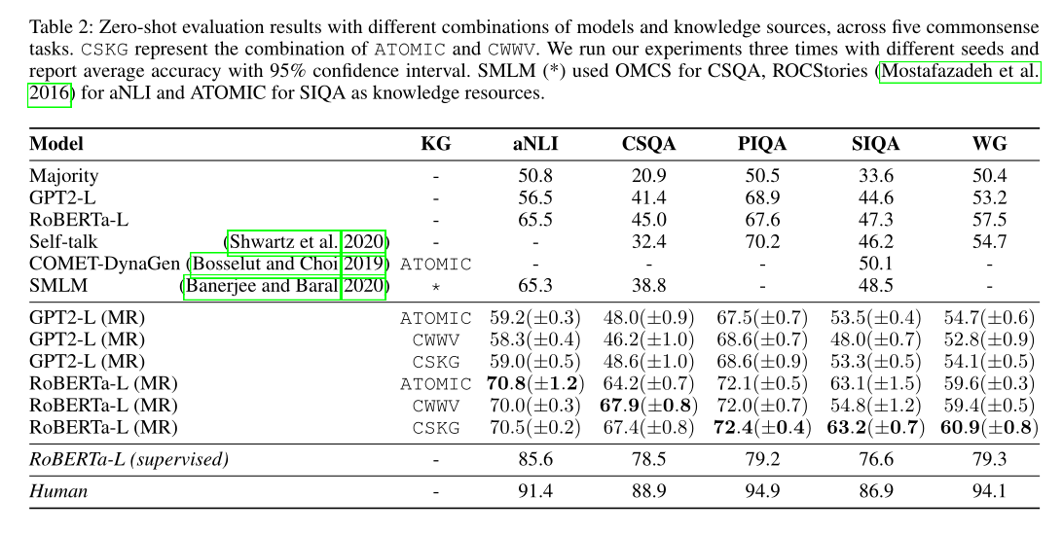
Results

Slide 10
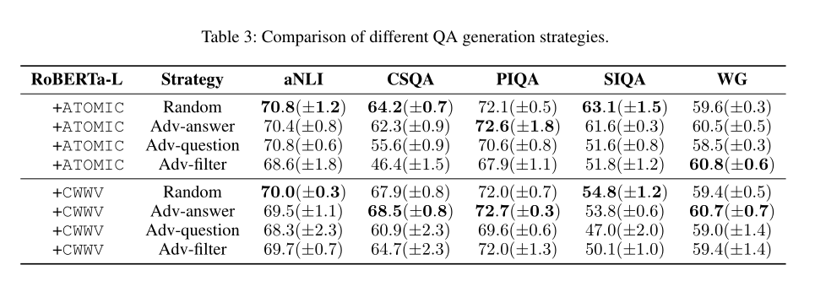
Results

Slide 11
Thank you！

